Slide 1
2018 Digital Survey: Feedback & Analysis
By
Lee-Ann Dell
&
Sally McElhayer
Notes:
Welcome to the results of the digital survey where we will provide feedback and analysis. Lee-Ann will be taking you through the result slides and I will be giving some feedback and helpful hints.

Slide 2
Facts and figures
30th October
12 questions
116 responses
Notes:
On the 30th October the survey was emailed to all the distributor contacts we have on file and remained open for 2 weeks
We asked 12 questions to help get an idea of your opinions on our current product & services and what you would like from us in the future
We were really pleased to received 116 responses with some amazing feedback so we’d like to take this opportunity to thank you by showing you the results, giving feedback and sharing our hopes for the future.
Question – Which sector do you think the majority of your digital customers come from?

Slide 3
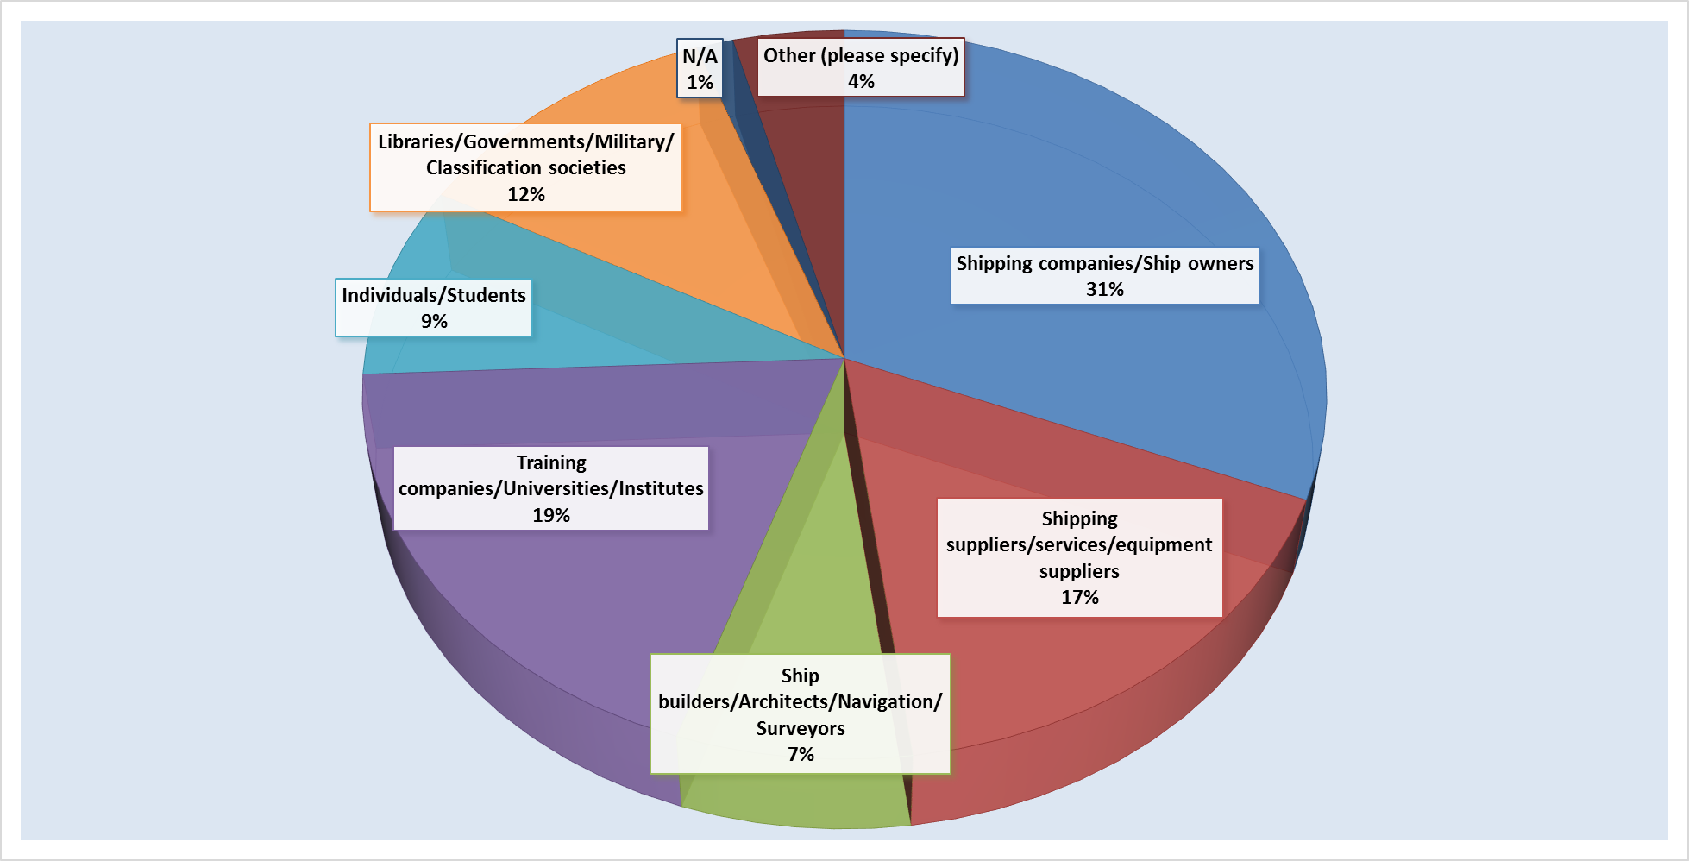
Which sectors do your digital publication customers come from?
Notes:
Shipping companies and ship owners were at the top of the list but with only 31%. It was interesting to see training companies 2nd. We hope this varied list will show that there are many opportunities to promote and sell digital rather than just concentrating on the shipping companies.

Slide 4
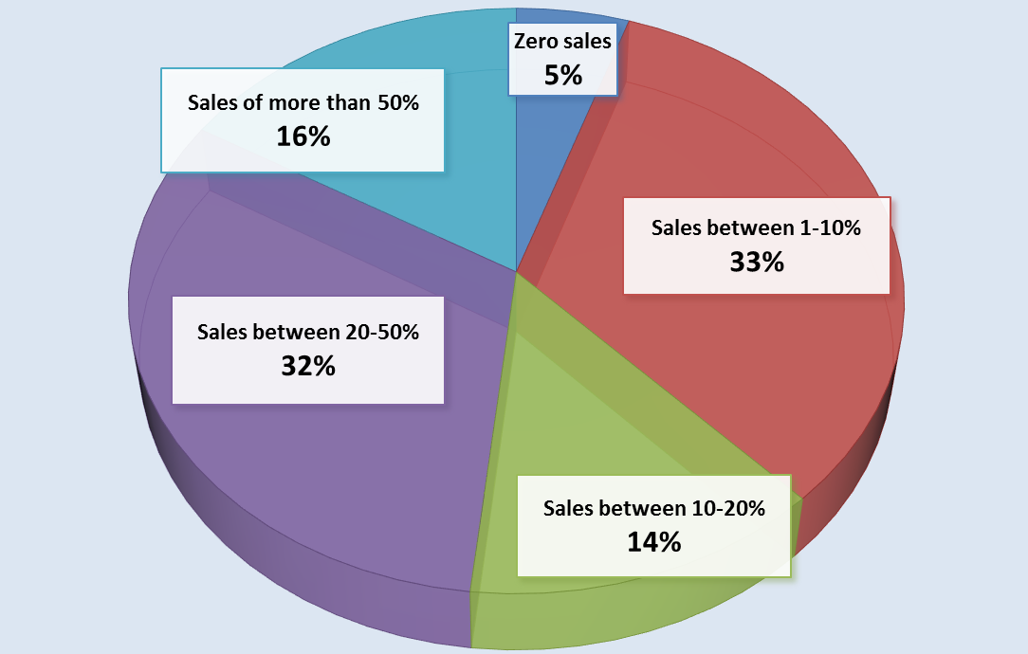
What proportion of your publication sales do digital publications account for?
Notes:
We are pleased to see digital publications sales are good in general with 48% having annual sales of 20% or over. IMO Publishing are in the green section with sale between 10 to 20%. Paper copies are still the majority of our revenue at this point.

Slide 5
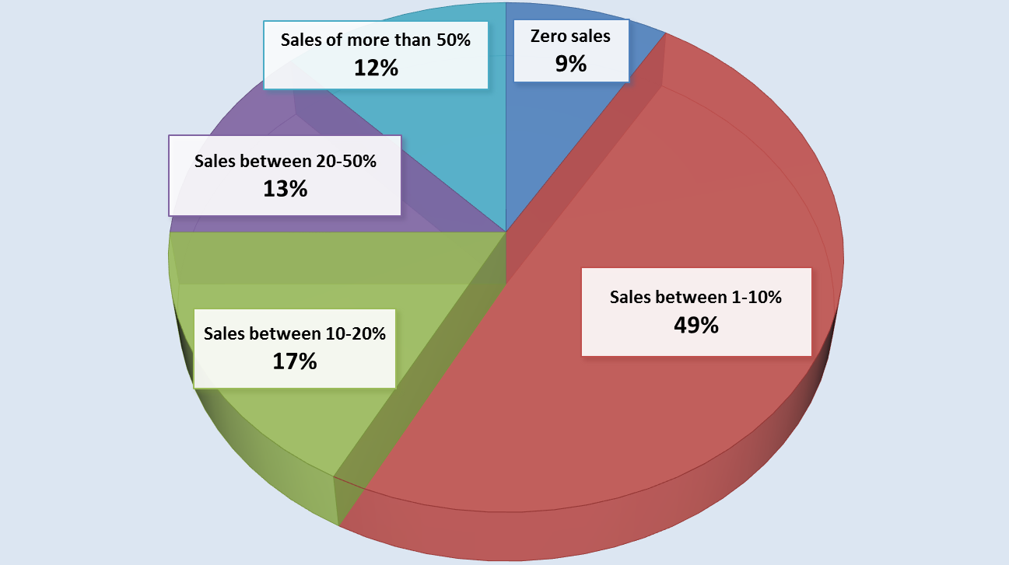
What proportion of these sales are for IMO digital publications?
Notes:
Out of these sales only 1-10% are IMO titles which is a percentage we believe there is scope to improve

Slide 6
How easy is it to order digital publications via IMO Publishing's B2B online bookshop?
Notes:
It’s good to see that the majority of users find purchasing digital titles easy. Those who found it difficult gave reasons such as losing their password or having to pay by credit card

Slide 7
How easy is it to use IMO Publishing's Virtual Publications site?
Notes:
With regards to the virtual publications site the majority of users are happy with the service provided. Those who found it difficult gave reasons such as wanting it to be more user friendly and quicker.

Slide 8
Which IMO Publishing digital products do you sell regularly?
Notes:
As expected the majority of you are selling e-readers. We would hope that you would look into subscriptions and downloads, IMO-Vega can be an essential tool for your customers who require current and historical information from IMO

Slide 9
Which of the options below could be of interest to your end users in the future?
Notes:
We asked which of these future solutions would be of benefit to you and your customers. The highest figure was for a network version followed by more back up licences at point of purchase at an increased price.

Slide 10
Are you actively promoting the use of IMO Publishing's digital publications?
Notes:
We are happy to see 75% of our distributors are actively promoting digital. We hope to encourage and assist the other 25% and will give some ways we can help later in the presentation

Slide 11
Do you find it easy to demonstrate IMO Publishing's digital products to customers?
Notes:
It is also good to see that 72% of you find it easy to demonstrate digital, for those who find it difficult we have included some tips later

Slide 12
Would you benefit from additional training on IMO Publishing's digital products?
Notes:
Another positive step is that 62% would like to receive digital training. we have some interesting solutions for this which we will share soon.
With a show of hands how many people in the room think digital will replace paper?

Slide 13
Will digital replace paper?
Notes:
80% of answers suggested that digital will not replace paper soon. With 45% saying never and 35% saying maybe in the future but not right now. At the end of the day no one knows what will happen with the future of digital but we want to be ready with user friendly products and robust delivery mechanisms.
Now I will hand over to Sally who will take you through our promotional tools and our vision for the future of digital.

Slide 14
Reasons for not promoting digital
Too time consuming
No demand
Low profit margins
Confusion over flag
state requirements
Licensing issues
Notes:
I will now take you through the reasons given for not promoting digital.
Firstly you found the purchasing and after sales support too time consuming
Many suggested that their customers still prefer paper
We found it interesting that some of you find there is no profit margin in digital
There is still uncertainty about the validity of digital on board ship and which flag states allow it and which don’t
The back up licence is still one of your main concerns and I will talk more about that at the end

Slide 15
How can we help you promote digital?
2-day free trial of web-based subscriptions
Free demo product for the IMO Bookshelf
Instructions and code sheets
Notes:
Here are some ways we can help you promote digital to your customers.
Firstly we offer a free two day trial of our web based subscription so customers can get a feel of the products and their many benefits
We can supply a free demo product for the IMO Bookshelf to help you demonstrate the product’s features to your customers.
Finally our website is full of instructions documents and code sheets to help make you aware which titles are available and in what format

Slide 16
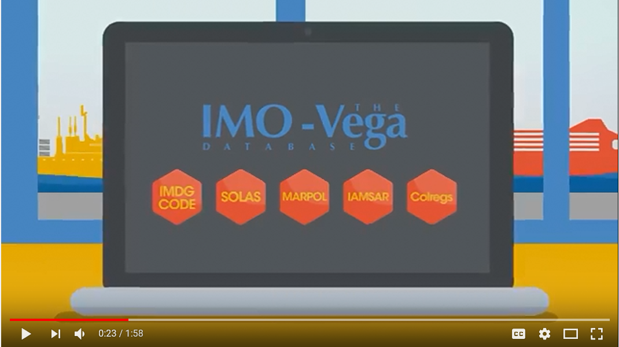
Suggestions for training
YouTube videos
Notes:
As many of you expressed an interest in training here are some of the methods available. We currently have a very popular promotional video for IMO-Vega on YouTube and we hope to produce more videos soon as this was the most popular choice

Slide 17
Suggestions for training
Live on-line tutorials
Notes:
We are able to give you access to one of our computers remotely through a service called teamviewer (or another service of your choice) and help you or your customer with product training

Slide 18
Suggestions for training
Face-to-face
Notes:
During distributor visits we are always happy to help answer any questions or give demonstrations to your sales staff. We can also attend seminars if you would like to arrange an event or training for your clients. You can also visit us and receive training in our conference room

Slide 19
What you would like to see in the future
Network version
A product with more back-up licences
De-install – Re-install
A more streamlined solution
All titles on one platform
Demo licenses
Additional training
Notes:
This is a list of your top ‘wish list’ items from the survey feedback we received, which is now our ‘to do list’. We hope to rework our e-commerce site in 2019 and we’ve initiated talks with Witherby to create a new vessel license for the IMO Bookshelf which will be sold alongside our current standard license. If you feel there is anything missing from this list please let us know.

Slide 20
Questions
Notes:
Finally we have time for a few questions so please feel free to ask us anything regarding digital

